Slide 1


Semantic Attachments for Domain-Independent Planning System
Elective in Artificial Intelligence
Reasoning Agents
Prof. Fabio Patrizi
Giorgia Natalizia - 1815651

Slide 2
Outline
Introduction
Examples of real problems
Semantic attachements
Implementation
Experiments
Conclusions

Slide 3
Introduction
Planning of high level tasks could be very challenging and several approaches has been developed for example hierarchical decomposition:
Top down
Bottom up
Third approach that integrates high and low-level planning. Low-level reasoner can provide information to the high-level planner during the planning process, but is only evoked if relevant to the high-level planner.
To integrate information about special-purpose reasoning into symbolic planning are used semantic attachments to a planning domain description such as PDDL.

Slide 4
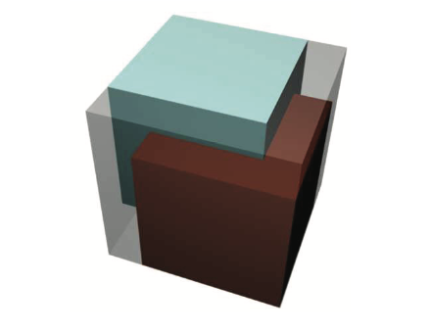
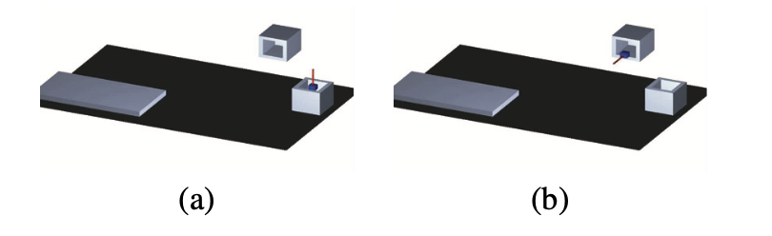
Examples of real problems
Transport domain
Robot manipulation domain
Common logistic prooblem when trucks deliver multiple packages to different locations
Blocks-word domanin in which we have a box which is open at the top, a shelf, a table, and a little moveable box The gripper is simply a stick that can connect to moveable objects

Slide 5
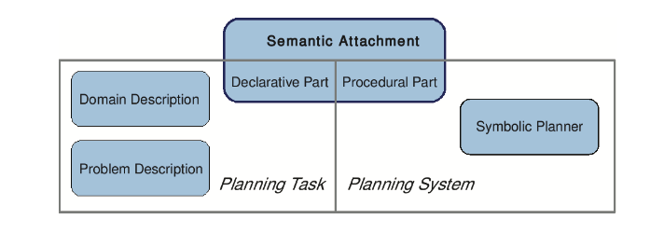
Semantic attachments
Semantic attachments are external procedural reasoning modules that may compute the valuations of state variables at planner run-time.
Declaratve part: describes their use in planning domain
Procedural part: is the actual algorithm for computing the value of a state variable

Slide 6
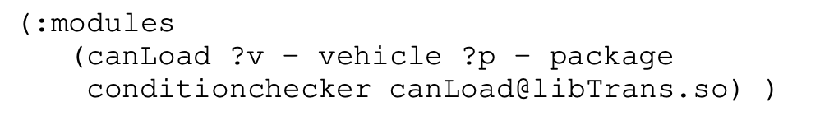
Implementation
It is necessary to extend the description language for planning tasks.
We use new PDDL requirement :modules to indicate that a planning domain uses semantic attachments. They are very similar to predicates and have condition-checker (test preconditions) and effect-applicator (compute changes to any state variable).
Sound and complete under the following assumption:
Condition-checker always terminates and return a truth value
Effect -applicator always terminates and return same values for the same settings.

Slide 7
Implementation
Modules are implemented as dynamically loaded shared libraries. Planner and the modules need to use a common interface that defines two function types for the two kinds of semantic attachments implemented.
Two search planners has been extended:
FF/M: FF/M is an extension of FF supporting semantic attachments.
TFD/M: is an extension of a domain-independent progression search planner supporting semantic attachments. Has 2 main phases: Translation and search.
Sound and complete under some assumption.
Can be integrated in heuristics.

Slide 8
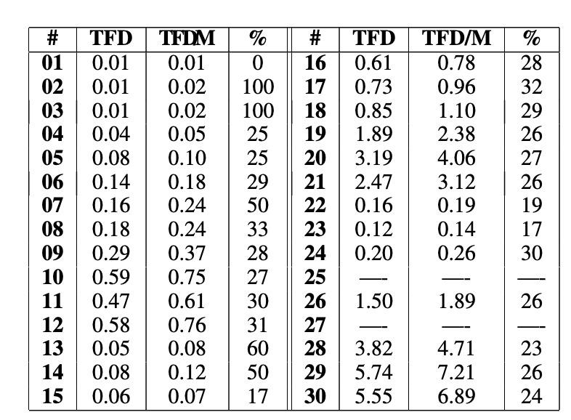
Experiments
This experiment is based on crew-planning domain of IPC 2008 which contains different operators with the predicate available in common.
In the experiment there is a comparison of the runtime of TFD and TFD/M in the execution of a callback requesting the truth value of the predicate available.
EXPERIMENT 1
There is an overhead introduced by module calls but usually the module’s calculations takes the majority of the time.

Slide 9
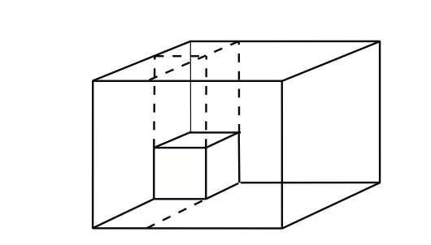
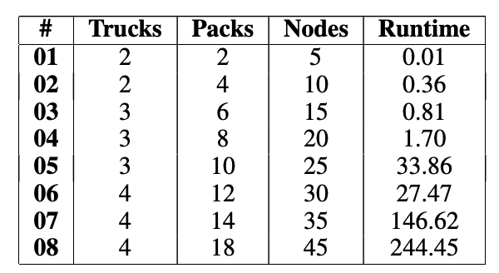
Experiments
Full implementation of PDDL/M with non-trivial semantic attachments in a classic logistic task.
EXPERIMENT 2
Semantic attachment are implemented as condition-checker module canLoad in order to fit a truck with the possible packages (correct but non optimal solution)

Slide 10
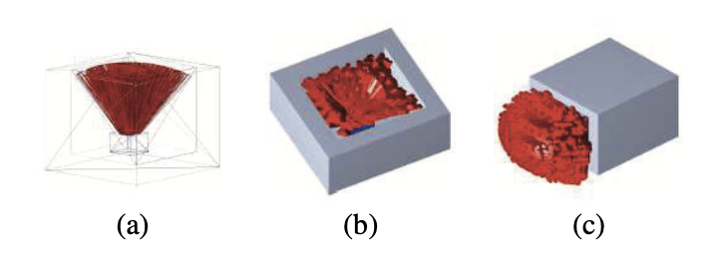
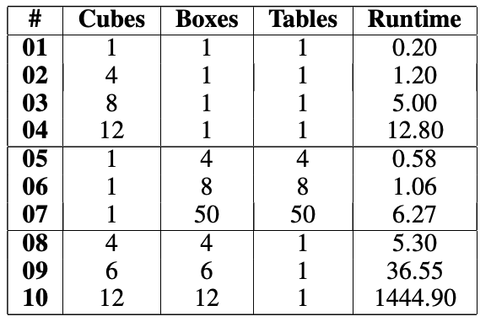
Experiments
Plan based robot manipulation.
Each pose is defined as a tuple
p = (rotx (p), roty (p), rotz (p)), where for i ∈ (x, y, z), roti(p) ∈ [0, 2Π] is the rotation of the robot gripper around the i axis. The module check all the possible grasp poses.
EXPERIMENT 3
The task consists of multiple cubes that have to be moved out of boxes onto a single shelf. Tables serve as temporary placement possibilities where grasp poses could be changed if necessary. Using FF/M
solve the problem in reasonable time.

Slide 11
Conclusions
Using planning in real word problems could be difficult. In particular in robotics application the application domain may be very hard to describe declaratively but instead be computed when needed.
The presented approach integrates external reasoning mechanisms, so-called semantic attachments, directly into a planner.
This method provides the planner with better information reducing future execution failure.

